Slide 1
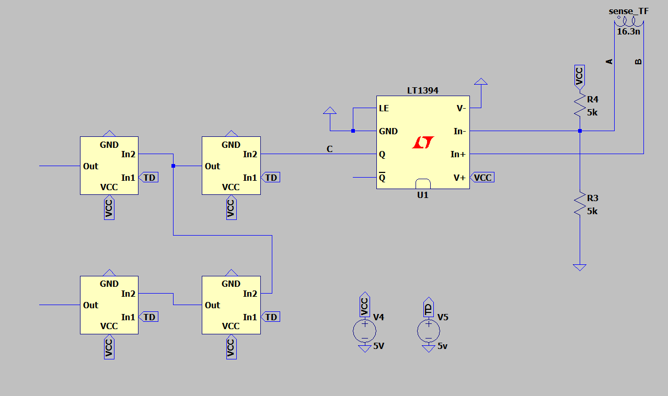
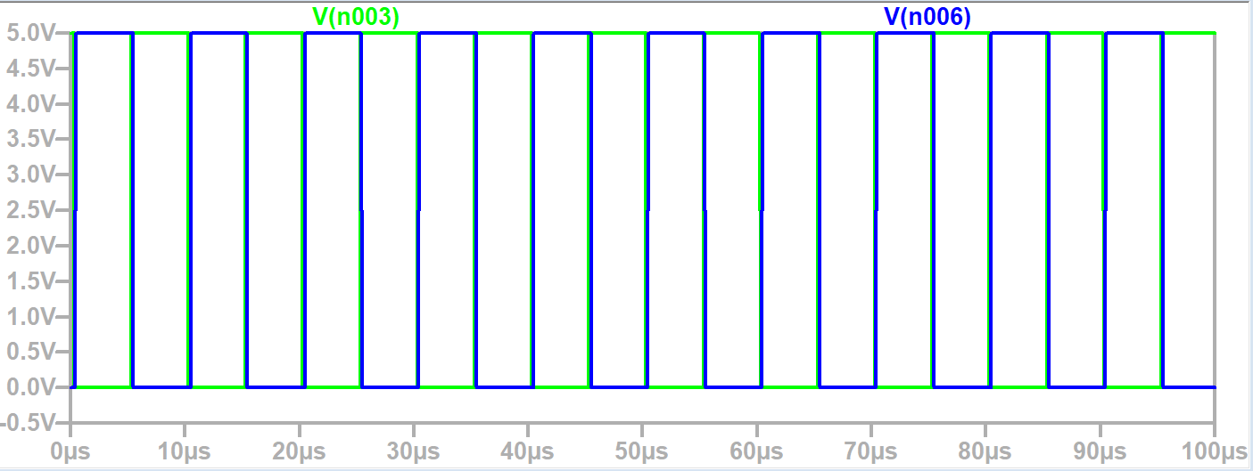
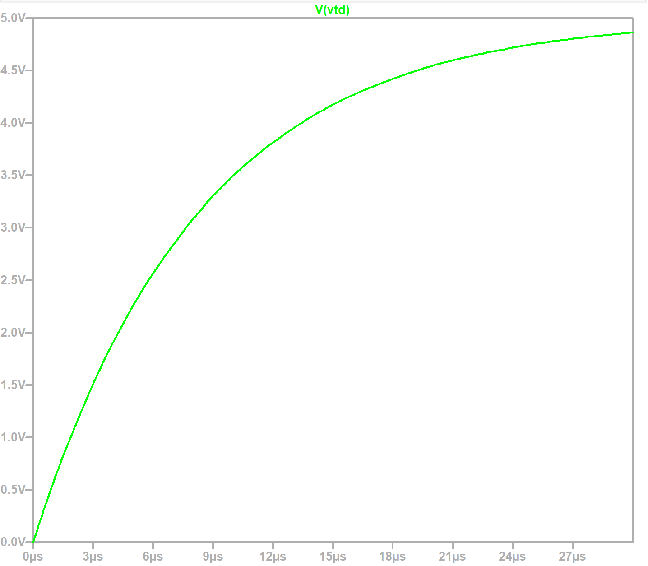
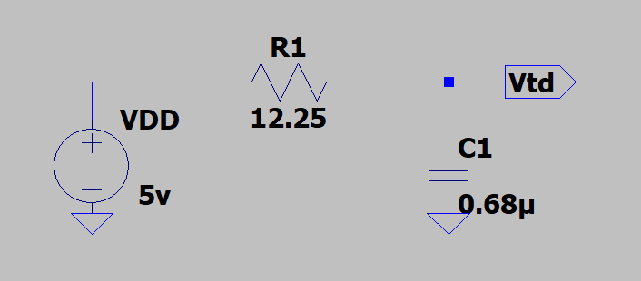
Implemented real NAND gates using SPICE models found online
Designed a methos of obtaining the time delay signal for the NAND gates.
What’s Next?
Find an LTSpice model for an appropriate MOSFET driver
Combine mine and Joe’s circuit to test the full external circuitry with optimised component values
V_th+
TD

